Slide 1
Binary Search Tree
BST

Slide 2
Binary Search Tree
A binary search tree, also known as an ordered binary tree, is a variant of binary trees in which the nodes are arranged in an order.
In a binary search tree, all the nodes in the left sub-tree have a value less than that of the root node.
Correspondingly, all the nodes in the right sub-tree have a value either equal to or greater than the root node.
The same rule is applicable to every sub-tree in the tree. (Note that a binary search tree may or may not contain duplicate values, depending on its implementation.)

Slide 3
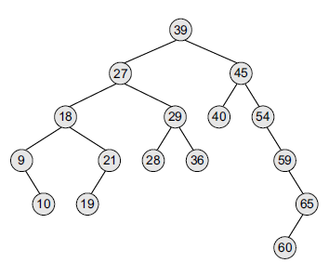
Binary Search Tree
The root node is 39.
The left sub-tree of the root node consists of nodes 9, 10, 18, 19, 21, 27, 28, 29, and 36. All these nodes have smaller values than the root node.
The right sub-tree of the root node consists of nodes 40, 45, 54, 59, 60, and 65.
Recursively, each of the sub-trees also obeys the binary search tree constraint. For example, in the left sub-tree of the root node, 27 is the root and all elements in its left sub-tree (9, 10, 18, 19, 21) are smaller than 27, while all nodes in its right sub-tree (28, 29, and 36) are greater than the root node’s value.

Slide 4
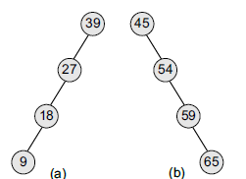
Binary Search Tree - Operations
Binary search trees speed up the insertion and deletion operations. The tree has a speed Advantage when the data in the structure changes rapidly.
Binary search trees are considered to be efficient data structures especially when compared with sorted linear arrays and linked lists.
In a sorted array, searching can be done in O(log₂ n) time, but insertions and deletions are quite expensive.
In contrast, inserting and deleting elements in a linked list is easier, but searching for an element is done in O(n) time.
However, in the worst case, a binary search tree will take O(n) time to search for an element. The worst case would occur when the tree is a linear chain of nodes as given in Figure.

Slide 5
To summarize, a binary search tree is a binary tree with the following properties:
The left sub-tree of a node N contains values that are less than N’s value.
The right sub-tree of a node N contains values that are greater than N’s value.
Both the left and the right binary trees also satisfy these properties and, thus, are binary search trees.

Slide 6
Binary Search tree
Operations

Slide 7
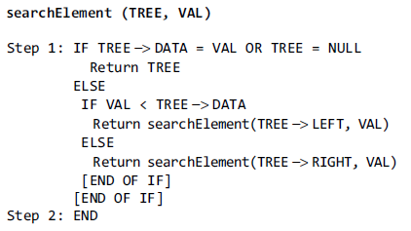
Searching for a node in Binary Search Tree

Slide 9
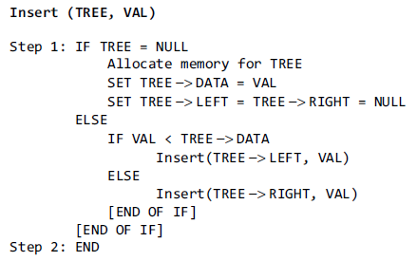
Insertion into Binary Search Tree

Slide 10
Insertion into Binary Search Tree

Slide 11
Construct Binary Search Tree by inserting following Nodes 39,27,45,18,29,40,9,21,10,19,54,59,65,60

Slide 12
Node Deletion
Binary Search Tree

Slide 13
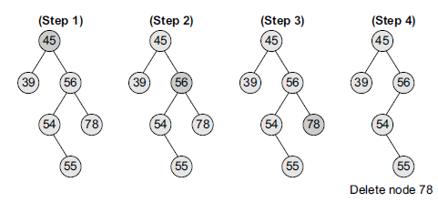
Deletion from Binary Search Tree
Case 1: Deleting a Node that has No Children
(This is the simplest case of deletion)
If we have to delete node 78, we can simply remove this node without any issue.

Slide 14
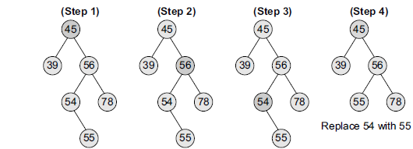
Case 2: Deleting a Node with One Child
the node’s child is set as the child of the node’s parent.
(i.e. replace the node with its child)
=> if the node is the left child of its parent, the node’s child becomes the left child of the node’s parent.
=> if the node is the right child of its parent, the node’s child becomes the right child of the node’s parent.
deletion of node 54

Slide 15
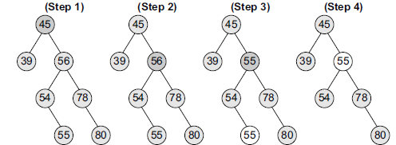
Case 3: Deleting a Node with Two Children
Replace the node’s value with either its
=> in-order predecessor (largest value in the left sub-tree) or
=> in-order successor (smallest value in the right sub-tree).
The in-order predecessor can then be deleted using any of the above cases.
deletion of node with value 56 (using in-order predecessor)

Slide 16
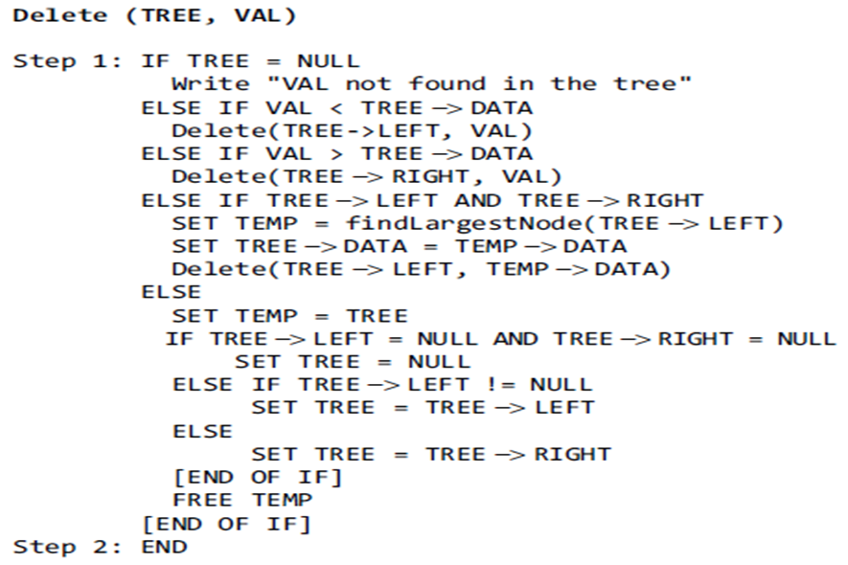
Algorithm for Deletion
Case 3
Case 1
Case 2

Slide 17
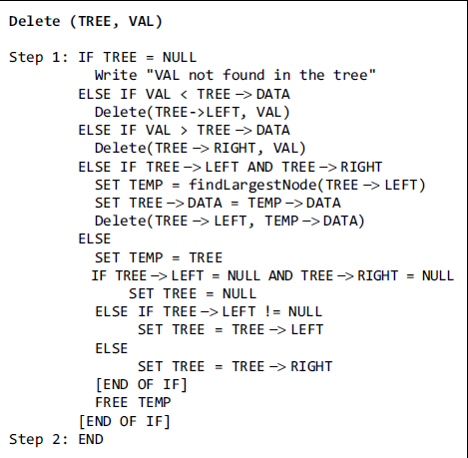
Example- Deletion
Delete 28, 54, 54, 9, 27, 59, 39, 29, 45
(using in-order predecessor & in-order successor )

Slide 18
Video Lecture of the topic can be found at
Binary Search Tree – Fundamentals
https://youtu.be/-6IqGvzUUTc
How to Perform Search & Insert Operation in Binary Search Tree (BST)
https://youtu.be/smE0gHcd5Gg
How to Delete Node in Binary Search Tree
https://youtu.be/ad1KFYHZyMc
Understanding Expression Tree data structure
https://youtu.be/qPoS1iM2JXY
Constructing Expression Tree from Postfix notation
https://youtu.be/WjnGmJ3zd58
Constructing Expression tree from Prefix Notation
https://youtu.be/e3WERX_uW3w
Constructing Binary Tree using PostOrder and PreOrder Traversals
https://youtu.be/RvO5oRqrJ3I

